Slide 1
Stakeholders: Involve People Affected by the Messy Problem
Developed by: Dave Gosselin Director Environmental Studies University of Nebraska-Lincoln

Slide 2
Pre-Activity Activities
Watch H2OMX documentary on Mexico City Water Issues. https://vimeo.com/103540456
Read SESYNC Case Study: Social--‐Hydrological Risk in the Mexico City Basin Student Handout. Be sure to explore resource video from PBS and the Non-Profit News article. Found in Resource Materials Folder
Notes:
Note: These activities and materials can be replaced by those more relevant to your class or project.

Slide 3
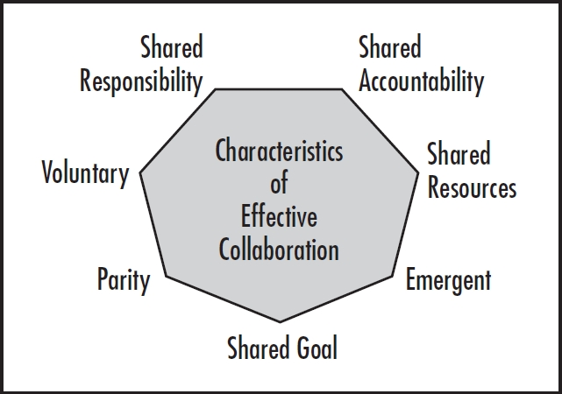
Reflect: Characteristics of Collaboration
(Shared Vision)
In Gosselin, 2015; Characteristics Adapted from Friend and Cook, 1996
Notes:
One of the most important attributes of the EMBeRS model is that developing an effective collaborative environment is important to addressing messy wicked problems. Identification of stakeholders is part of the process of developing shared goals and a shared vision for the project (click) The identification and inclusion of stakeholders is an emergent process, i.e., time and effort are necessary, that in the end will result in a better, more inclusive and effective approach to address the challenges of the wicked problem at hand.

Slide 4
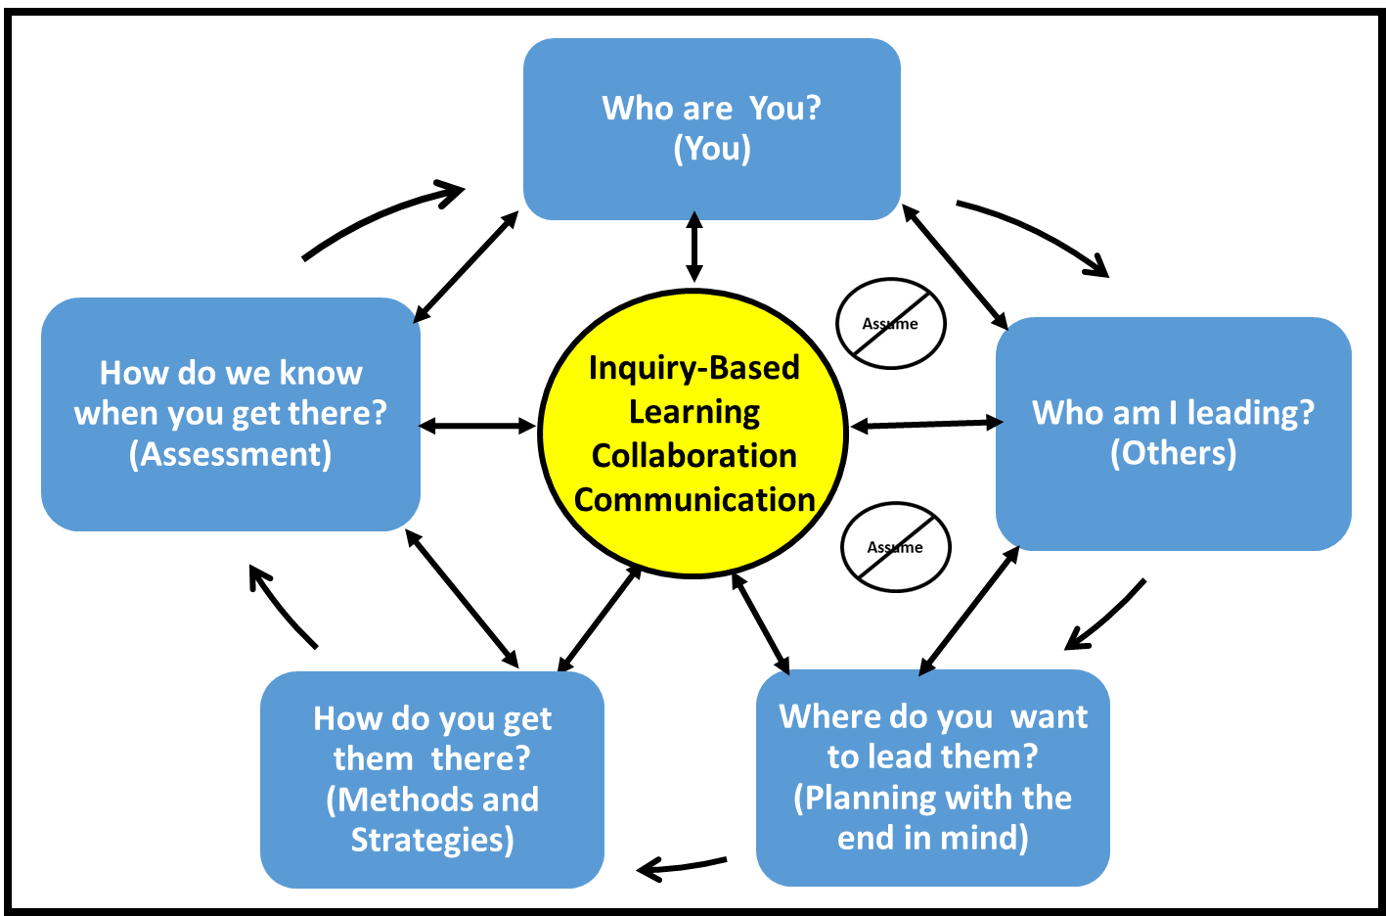
Framework: Collaborative Leadership Action Model (Gosselin 2015)
(Stakeholders)
Notes:
Stakeholders are fundamental components to any collaboration or team that is attempting to address wicked problems. Fundamental to the collaborative process outlined in Gosselin’s (2015) collaborative leadership action model is the knowing about who you are leading and involving them in the process (Click). Engaging all stakeholders in a communication process that allows them to inquire and know who you are, who the other stakeholders are, and knowing where each group wants to go (Click) cannot be overlooked or underemphasized as critical components to moving individuals, team or organizations forward to address messy problems. (Click) This module will provide some methods and strategies to move your team forward.

Slide 5
Resources
http://ctb.ku.edu/en/table-of-contents/participation/encouraging-involvement/involve-those-affected/main
https://www.mindtools.com/pages/article/newPPM_07.htm#Interactive
https://www.mindtools.com/pages/article/newPPM_08.htm
Notes:
Many web-based resources. These are examples and are used as the foundation for this educational activity.

Slide 6
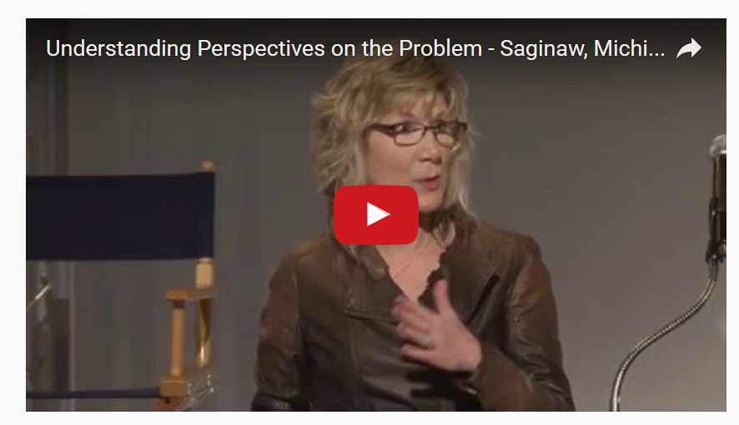
Why involve people most affected by problems?
https://www.youtube.com/watch?v=ZMdGRsV38RM
https://www.youtube.com/watch?v=ZMdGRsV38RM
Notes:
Instructors Note: Before watching the video, engage your group in a conversation as to why it is important to involve a range of groups in collaborative process when addressing community challenges and problems. A “Popcorn Approach” can be used. This requires a the Facilitator (or assistant) to capture participants’ responses and write them down for all to see on a white board, etc.
This approach gives the group a sense of the scope and variety of responses (especially useful for visual learners); in some cases, only new thoughts are written down, not duplicates
Watch the embedded video from the Community Tool Box. Click on the youtube video link https://www.youtube.com/watch?v=ZMdGRsV38RM

Slide 7
Why identify and analyze stakeholders and their interests?
Personal knowledge and experience
More Ideas
Multiple and new perspectives
Buy-in and support
Fairness and equity
Blindside Reduction
Notes:
Notes for Instructor: Before proceeding to the information on the next two slides, the group should have watched the video and engage in a small group or full group conversation (depending on size) as to why it is important to involve a range of groups in collaborative process when addressing community challenges and problems. Popcorn approach was suggested.
Notes: In the EMBeRS approach, we use a variety of approaches that allow individuals to share their mental models. One of these models is an analogy. Here is an analogy used on the Community Tool Box site to focus on the importance of identifying and analyzing stakeholders. So here goes, “Let's say that you have a rock in your shoe. No one other than you can know exactly how that rock feels. Others may have read about rocks, seen rocks, or even had a similar experience with a pebble caught in a sandal. However, you are the expert on this particular situation because you are experiencing it. The same concept applies to social and community problems. People who directly experience a problem have a much different outlook on their needs than does a politician who has only read about the problem in the newspaper or a helping professional who once wrote a college paper on the problem.”
1. The story highlights the fact that stake holders bring first-hand knowledge and experience to the problem. A clearer picture of the community context and potential pitfalls and assets should emerge.
2. More stakeholders = More ideas are represented
3. More, varied, and new perspectives from the sectors and elements of the community that are affected.
4. It gains buy-in and support for the effort from all stakeholders. Increases the likelihood of commitment to a plan’s development, planning, implementation, and evaluation. Stakeholders have the opportunity to make this their effort. They will take ownership to do their best to make it work.
5. It’s fair to everyone. All stakeholders can have a say in the development of an effort that may seriously affect them.
6. It will reduce the opportunities for you to be blindsided by perspectives and concerns you didn’t know about.
More on Why identify potential participants among diverse groups?
You can bring different types of members into your group. Thereforee, it will be more representative of the full community; your group will stand to gain broader community support.
Multi-sector membership brings results in more and different opinions being expressed and discussed; that should lead to better outcomes.
A diverse, multi-sector membership usually means more people – hence access to more and varied talent at your disposal.
More and diverse contacts and connections in a multi-sector group leads to new relationships that can spark new community initiatives that would not have come into existence without this process.

Slide 8
Why identify and analyze stakeholders and their interests? (continued)
Strengthens position
Creates social capital
Increases credibility of organization
Increases possibilities for success
Notes:
(Click) Having more stakeholders involved in the conversation strengthens your position by creating social capital (Click) for the community. Social capital cements relationships and strengthens the community by increasing the web of acquaintances, friendships, family ties, favors, obligations, and other social currency.
Through a participatory process and the development of social capital, the credibility of your organization increases (Click) . Involving and attending to the concerns of all stakeholders establishes your organization as fair, ethical, and transparent, and makes it more likely that others will work with you in other circumstances.
For all of the above reasons, identifying stakeholders and responding to their concerns increases the chances for the success of your effort (Click) .

Slide 9
What do we mean by stakeholders and their interests?
Affected or Effect
Interest- Many reasons
Level of Interests = f(how they affect or are affected) = Broad range of categories based on their values.
Primary, Secondary, and Key stakeholders.
Notes:
Instructors Notes: Up to this point, the assumption is that everyone knows what a stakeholder is. Ask your audience the question, “ What do we mean by stakeholders?” and “What are their interests?” Depending on time constraints – you could have them engage in think-pair-share. They note individual ideas (think), talk in pairs, then share their responses with the larger group. This approach will allow you to access previous knowledge and give the facilitator an understanding of where they are coming from. You are getting to know them and they are getting to know each other. The more you involve the relevant people the more buy in and commitment you will get.
Key Messages
Stakeholders are those who may be affected by or have an effect on an effort, issue, or concern in a community.
There are many reasons why individuals or groups may have an interest. These include those interested for intellectual, academic, political, or philosophical reasons, among others.
The interests of your stakeholders depend on how they affect or are affected by the effort. There are a broad range of reasons people are interested that relate to what they value and what is important to them. Examples of stakeholders’ interests can be many and varied as suggested at
http://ctb.ku.edu/en/table-of-contents/participation/encouraging-involvement/identify-stakeholders/main
A few of the more common:
Economics.
Social change.
Work
Time.
Environment.
Safety and security.
Mental health.
One way to categorize stakeholders based on their levels of interest is to consider the extent to which an individual or group will invest effort into the activity, challenge.
Stakeholders can be divided into primary, secondary, and key stakeholders. Giving consideration to the type of stakeholder will help focus you energy and resources.

Slide 10
Three Levels of Stakeholders
Primary
Directly affected, either positively or negatively
Direct Beneficiaries
Targeted Beneficiaries
Secondary
Directly involved or responsible for beneficiaries
Jobs or lives affected by process or results
Key
Government officials and policy makers
Influencers of others
Not Directly Impacted
Notes:
Information from http://ctb.ku.edu/en/table-of-contents/participation/encouraging-involvement/identify-stakeholders/main
Stakeholders are those who may be affected by or have an effect on an effort.
They can be divided into primary, secondary, and key stakeholders.
Primary
Direct Beneficiaries - gain something as a direct result of the effort – services, skills, money, goods, social connection, etc.
Targeted Beneficiaries - may or may not stand to gain personally, or whose actions represent a benefit to a particular (usually disadvantaged) population or to the community as a whole.
Examples are:
A particular population – a racial or ethnic group, a socio-economic group, residents of a housing project, etc.
Residents of a particular geographic area – a neighborhood, a town, a rural area.
A Group experiencing a particular problem or condition – homelessness, lack of basic skills, unemployment, diabetes.
People involved in a particular organization or institution – students at a school, youth involved in the justice system, welfare recipients.
Focused on Behavior Change – delinquent youth, smokers, people who don’t exercise.
Policy makers and agencies that are the targets of advocacy efforts.
Secondary
Directly involved with or responsible for beneficiaries or targets of the effort.
Those whose jobs or lives might be affected by the process or results of the effort
Parents, spouses, siblings, children, other family members, significant others, friends.
Schools and their employees – teachers, counselors, aides, etc.
Doctors and other medical professionals, particularly primary care providers.
Social workers and psychotherapists.
Health and human service organizations and their line staff – youth workers, welfare case workers, etc.
Community volunteers in various capacities, from drivers to volunteer instructors in training programs to those who staff food pantries and soup kitchens.
Key
Government officials and policy makers
Influencers of others - e.g, media, clergy
Not Directly Impacted - nonetheless care enough and are willing to work to influence its outcome.
More information from the Community Tool Box
One way to characterize stakeholders is by their relationship to the effort in question.
Primary stakeholders are the people or groups that stand to be directly affected, either positively or negatively, by an effort or the actions of an agency, institution, or organization. In some cases, there are primary stakeholders on both sides of the equation: a regulation that benefits one group may have a negative effect on another. A rent control policy, for example, benefits tenants, but may hurt landlords.
Secondary stakeholders are people or groups that are indirectly affected, either positively or negatively, by an effort or the actions of an agency, institution, or organization. A program to reduce domestic violence, for instance, could have a positive effect on emergency room personnel by reducing the number of cases they see. It might require more training for police to help them handle domestic violence calls in a different way. Both of these groups would be secondary stakeholders.
Key stakeholders, who might belong to either or neither of the first two groups, are those who can have a positive or negative effect on an effort, or who are important within or to an organization, agency, or institution engaged in an effort. The director of an organization might be an obvious key stakeholder, but so might the line staff – those who work directly with participants – who carry out the work of the effort. If they don’t believe in what they’re doing or don’t do it well, it might as well not have begun. Other examples of key stakeholders might be funders, elected or appointed government officials, heads of businesses, or clergy and other community figures who wield a significant amount of influence.
While an interest in an effort or organization could be just that – intellectually, academically, philosophically, or politically motivated attention – stakeholders are generally said to have an interest in an effort or organization based on whether they can affect or be affected by it. The more they stand to benefit or lose by it, the stronger their interest is likely to be. The more heavily involved they are in the effort or organization, the stronger their interest as well.

Slide 11
When should you identify stakeholders?
When?
Participatory
Transparent
Impacted
Legal
ASAP
Notes:
In general, stakeholders and their interests should be identified and involved/addressed as early in the process of the development of the effort as possible.
Participatory – in process or in action research

Slide 12
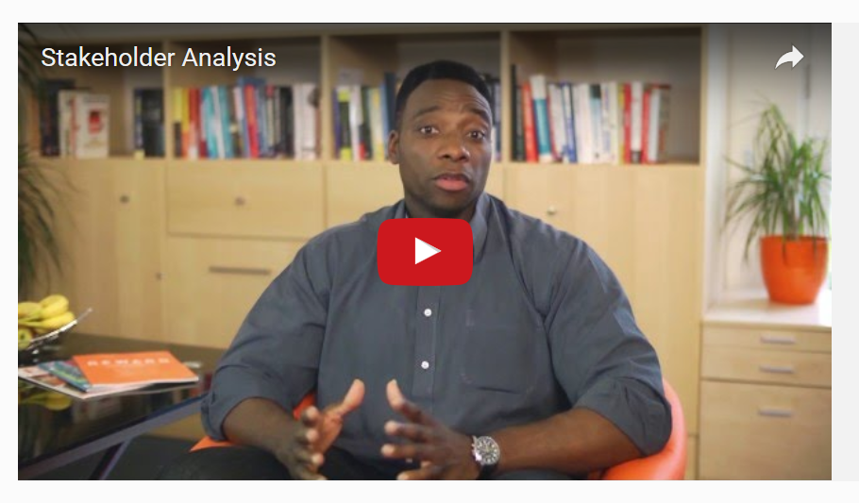
https://www.mindtools.com/pages/article/newPPM_07.htm#Interactive
https://www.youtube.com/watch?v=9Fzfrcqqv5o
Notes:
Watch the embedded video from Mind Tools. One of the important outcomes from working with stakeholders is the creation of a successful project.

Slide 13
How do you identify and analyze stakeholders and their interests?
To Identify Stakeholders:
Brainstorm
Collect information from individuals
Consult organizations involved in similar efforts, populations or areas of concern.
Idea stakeholders from new stakeholders (Snowballing)
Advertise.
Secondary Data and Government Statistics
Notes:
There a variety of processes that can be used to first identify the stakeholders in the project, who are then analyzed as to their level of interest in order to improve understanding of the stakeholders.
A multilevel approach should be used. The first is to start with brainstorming where each individual using their knowledge and ideas come with a list of people and organizations who may have an interest in the project.
Collecting categories and names from informants in the community.
Consulting with organizations that either are or have been involved in similar efforts, or that work with the population or in the area of concern.
Getting more ideas from stakeholders as you identify them.
If appropriate, advertise.
Secondary data (e.g. historical records, correspondence files, newspaper articles, census information). Government statistics and data, such as census information, which provide information about a local area and its demographic characteristics that should be taken into account.

Slide 14
Step 1 – Identify Your Stakeholders
Notes:
We are going to use a three step process that starts with the identification of stakeholders.

Slide 15
Step 1. Identify Your Stakeholders Application to Mexico City
1. Individual – Personal Brainstorm - use sticky notes to record stakeholders – write down whatever comes to your mind – post to white board
2. Collectively – Organize Stakeholders – Primary, Secondary, Key
Silent – move and organize the stakeholder sticky notes into primary, secondary, and key
Negotiate - organize the stakeholder into primary, secondary, and key
Notes:
We will apply the process to water issues in Mexico City. See pre-activity materials. We will start our process using brainstorming. When brainstorming, criticism of ideas generated should be put 'on hold'. Instead, participants should focus on extending or adding to ideas, reserving criticism for a later 'critical stage' of the process. By suspending judgment, participants will feel free to generate unusual ideas.
We will start at the individual level using your current knowledge and experience. Personal brainstorming - just by yourself - is very useful for the start of any new project. Record your personal brainstorm items using individual sticky notes to record each stakeholder or stakeholder group – write down whatever comes to your mind – post to white board. There are no right or wrong responses. All responses need to be respected.
(Click) Part 2 of our process is to collectively, organize the stakeholders into stakeholder categories – Primary, Secondary, and Key. Start by doing this silently ….Once everyone has been give the opportunity to participate in the silent negotiation. A potential way to start is to give everyone the opportunity to move a sticky note into a category. Sequentially do this until all sticky notes have been organized. Now ask each person can silently move sticky notes to other locations if they so desire.
Go to an interactive group activity to discuss and negotiate the organization.

Slide 16
Step 1 – Identify Your Stakeholders
Step 2 – Prioritize Your Stakeholders

Slide 17
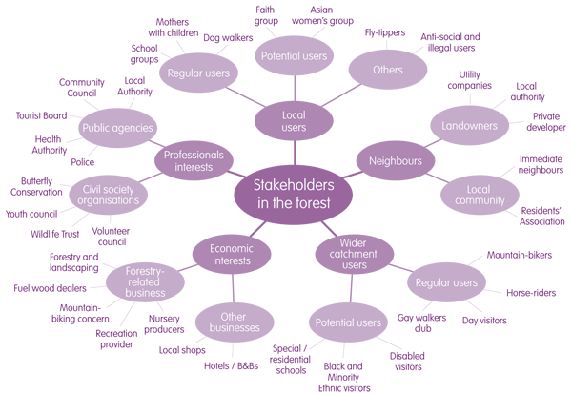
Step 2a – Prioritize/Map Your Stakeholders
Construct an Stakeholder (Influence) Map
Map the Relationships between Stakeholders
Notes:
Overview – Activity starts on next slide: Stakeholder maps are visual diagrams that depict the relationship of stakeholders to the solution and to one another. There are many forms of stakeholder map, depending on the issues being examined and the creators preferences. These are visual models
Why do it?
Stakeholder maps help identify particular stakeholders or stakeholder groups who have specific characteristics; or who need or may benefit from specific contact or management strategies. They also help guide stakeholder analysis and management discussions among the project team. However, the key benefit of Stakeholder Maps is not the maps themselves, but the analysis and discussion among the project team that goes into making them.
The results of creating a stakeholder map should be a better understanding of stakeholders in relation to the project and each other. The process of creating the map should result in knowledge of the stakeholders that will guide further stakeholder analysis and the stakeholder management effort.
As you map, it is important to document the interests and motivations of stakeholders in the project. Also, identify relationships between stakeholders and potential conflict interests between stakeholders. The level of participation required from each stakeholder should be considered as well.
Risks
As with most graphs, there is always a risk of over-simplifying information in order to make it fit the graph design. This can detract from the value of the underlying analysis.
As always with Stakeholder Analysis efforts, the project team may want to be cautious about sharing these maps outside of the project team. Labeling different stakeholder power and support levels can be a sensitive issue and could result in unwanted problems.
Tips
It’s often easier to start with the more simplistic stakeholder maps, and use the discussion and results of those efforts to create more complex maps with more complex underlying analysis.

Slide 18
Step 2a – Prioritize/Map Your Stakeholders
Construct an Stakeholder Influence Map
Application to Mexico City
Notes:
There are three considerations when you construct a stakeholder influence map for the Mexico City Application. One a piece of paper create a stakeholder influence map using the following design scheme.
The importance or weight of a stakeholder's overall influence (represented by the size of the circle representing that stakeholder).
The relationships between stakeholders (represented by the presence of lines or arrows between them). You should include the identification of potential conflict of interests.
The amount of influence stakeholders have over others (represented by the heaviness of the lines).
The results of creating a stakeholder map should be a better understanding of stakeholders in relation to the project and each other. The process of creating the map should result in knowledge of the stakeholders that will guide further stakeholder analysis and the stakeholder management effort.

Slide 19
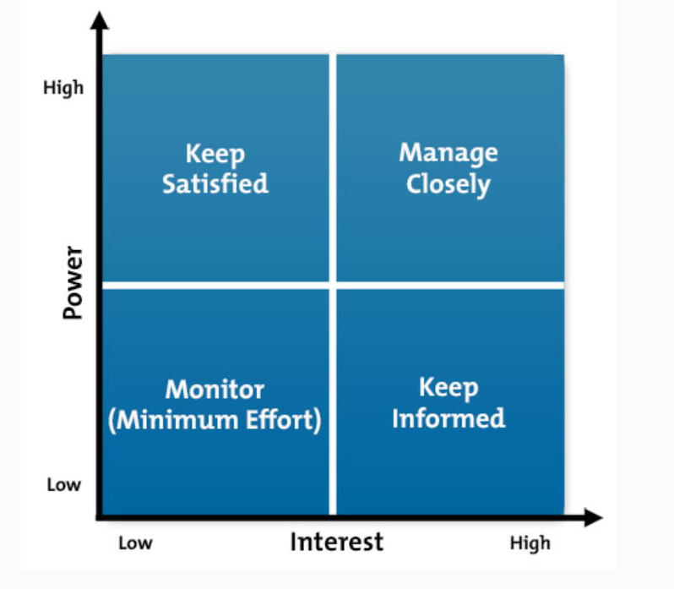
Step 2b – Prioritize/Map Your Stakeholders
Power/Interest Grid for Stakeholder Prioritization
High power, interested people: these are the people you must fully engage and make the greatest efforts to satisfy.
High power, less interested people: put enough work in with these people to keep them satisfied, but not so much that they become bored with your message.
Low power, interested people: keep these people adequately informed, and talk to them to ensure that no major issues are arising. These people can often be very helpful with the detail of your project.
Low power, less interested people: again, monitor these people, but do not bore them with excessive communication.
https://www.mindtools.com/pages/article/newPPM_07.htm#
Notes:
Now that you have identified relationships and the potential level of interest, the next phase is to use a power – interest grid to prioritize stakeholders and their management.
The Power/Interest Grid contains four quadrants. Each quadrant gives you an indication of the level of stakeholder management that you’ll have to employ. This will influence your communication strategy. The four quadrants of the Power/Interest Grid are shown in this diagram Stakeholders that lie in the Manage Closely quadrant can easily ensure project failure, if you don’t manage them properly. You can access a Power/Interest Grid in the resource folder.
An example from MindTools: You are the project manager of a consulting project. The sign-off authority on the deliverables is someone who’ll fall in the Manage Closely quadrant in the Power/Interest Grid. However, your business development manager (the person that got your organization the contract) does not need to be managed closely. You may want to include her in the Monitor quadrant.
As you might have already deduced, interest is very subjective and can be error prone. You might think a certain stakeholder has a high level of interest in project success, but in relative terms, may actually not. For example, a project manager has a very high interest in ensuring the project is successful. This success would in turn impact the bottom line of the organization. The bottom line is of very high interest to the CEO and CFO. However, there are several other factors that play a role in impacting the bottom line. Therefore, in relative terms, the CEO and CFO interest will not be as interested in your project success as your Program Manager.
Advantages and Disadvantages of Grid
Advantages:
Help discover where the real power over a project is located and therefore makes for better project decisions
Help find relevant communication strategies for different stakeholders
Disadvantages:
Can be subjective
Needs to be used on regular basis throughout the process.
Plotting a stakeholder on this matrix does not show his attitude towards our initiative. We do not know whether a stakeholder is for or against it. Symbols like (+, -, or 0) can be used to indicate stakeholder attitude - symbols show positive, negative or neutral attitude.

Slide 20
Step 1 – Identify Your Stakeholders
Step 2 – Prioritize Your Stakeholders
Integrate Representations - Identify facilitator(s)
Share with other group – Identify presenter
Notes:
One a piece of poster paper integrate your representations – stakeholder map and stakeholder influence map and power interest grids. A facilitator should be chosen along with a recorder for your group.
A presenter should be identified who will share your representations with the other groups.

Slide 21
Step 1 – Identify Your Stakeholders
Step 2 – Prioritize Your Stakeholders
Step 3 – Understand Key Stakeholders
(Know your Stakeholders)
Notes:
You have identified stakeholders and given them a priority level in terms of their interest and power that they may bring to the project. This is the beginning. You now need to learn more about your key stakeholders. You need to know how they to feel about the project. You also need to know how best to engage them in your project. Gaining this knowledge will help you learn how to communicate with them.

Slide 22
Step 3 – Understand Your Stakeholders
Obtain the following file from the Resource Folder to improve your understanding of your stakeholders:
Stakeholder Analysis Questionairre_Know your Stakeholders
Action Item: Develop a list of specific strategies you would use to engage your stakeholders so you can learn more about them?
Notes:
A very good way of getting to know your stakeholders is to talk to them directly – people are often quite open about their views, and asking people's opinions is often the first step in building a successful relationship with them. Obtain the following file from the Resource Folder as a starting point in your process to improve your understanding of your stakeholders: Stakeholder Analysis QuestionnaireKnow your Stakeholders
Based on the information you obtain from your stakeholders, you can add information to your stakeholder map and interaction grid. This new information will provide you to assess stakeholders in the context that they will be blockers or critics, or will be advocates and supporters or your project. This information can be provided on your diagrams using a color code: showing advocates and supporters in green, blockers and critics in red, and others who are neutral in orange.
Action Item: Develop a list of specific strategies you would use to engage the stakeholders you have identified for the Mexico City Water Crisis scenario so you can learn more about them ?

Slide 23
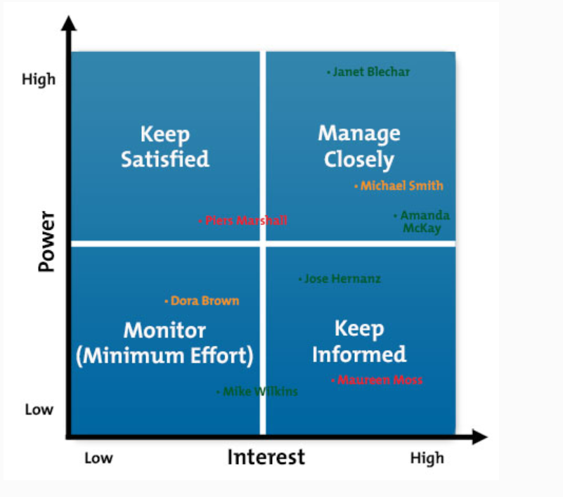
Step 3 – Understand Your Key Stakeholders
Choose five stakeholders
Advocacy Level Coding
Advocates and supporters in green
Blockers and critics in red
Neutral in orange.
https://www.mindtools.com/pages/article/newPPM_07.htm#
Notes:
Using information from the Stakeholder Analysis Questionnaire revise your power interest grid for five stakeholder. Use color coding to define the level of advocacy that you expect from these advocates.

Slide 24
Manage Your Stakeholders (Planning Communication with Stakeholders)
1. Use Maps and Power/Interest Grid: Use information to identify five stakeholders on whom you will focus.
2. Plan Your Approach to Stakeholder Management: - What help do you need? How much time will need to be invested manage and communicate with stakeholders?
3. Identify What You Want From Each Stakeholder: What levels of support do you want from them? What roles would you like them to play (if any)? What actions would you like them to perform?
4. Identify the Messages: You Need to Convey to your stakeholders to persuade them to support you and engage with your projects or goals.
5. Identify Actions and Communications – What do you need to do to win and manage the support of these stakeholders? With the time and resource you have available, how will you manage the communication to and the input from your stakeholders.?
Notes:
Focus on the high-power/high-interest stakeholders first and the low-interest/low-power stakeholders last. Devise a practical plan that communicates with people as effectively as possible and that communicates the right amount of information in a way that neither under nor over-communicates.

Slide 25
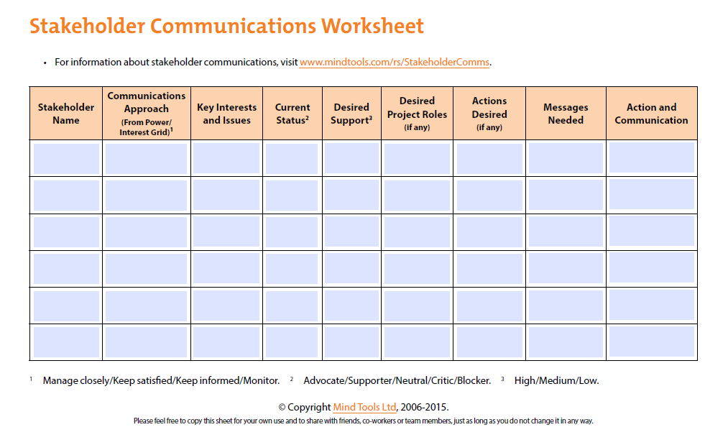
Manage Your Key Stakeholders
Notes:
Open the following worksheet in the resource folder to summarize the management components for your key stakeholders related to the Mexico City Water Crisis Scenario.

Slide 26
Last Words
http://ctb.ku.edu/en/table-of-contents/participation/encouraging-involvement/involve-those-affected/main
https://www.mindtools.com/pages/article/newPPM_07.htm#Interactive
https://www.mindtools.com/pages/article/newPPM_08.htm
Notes:
There are many resources that can be used to facilitate stakeholder involvement. There are many tools, similar to the ones modeled, in this module that can help you manage the people and perspectives that come long with working on interdisciplinary and transdisciplinary team projects. Developing your skills to communicate and facilitate interactions with teams will help you win support for your project and reduce project stress.

Slide 27
Post Session Five-Minute Writing Reflection.
What did you learn about involving stakeholders in messy problems? How have your views been informed by the rest of this activity and interactions with the group? What new insights do you take away?

